Slide 1


Bitcoin Price Prediction Using Machine Learning Technique
X THE PLACE OF USEFUL LEARNING
Group 8 Preeti Suryawanshi
Bhaskar Sinha
Eitika Sharma
Abu Huraira
Sushmitha Sannasanth
Salman Tahir Khan

Slide 2


History and context
Bitcoin came into existence in response to the Global Financial Crisis of 2008
Aimed to remove intermediaries like banks between transactions and build a decentralized financial system.
Once dismissed as a ponzi scheme is now adopted by countries as legal tenders and institutional investors like Black Rock.

Slide 3
Challenges ?
Bitcoin’s price is highly influenced by various factors:
Short history makes predicting less reliable
Regulatory changes worldwide causes abrupt market shifts
investor sentiments
market demand
regulatory news
tech advancements

Slide 4
Data Overview
We collected data from various cryptocurrency platforms, including Yahoo Finance, Quandle to analyze Bitcoin price trends alongside variables like Gold, Litecoin, Ethereum prices (in USD), BTC volume/popularity, BTC_CASH (in USD), and other features.
The dataset spans from 2015 to 2024. We preprocessed the data to handle missing values and ensure linearity before further analysis.

Slide 5
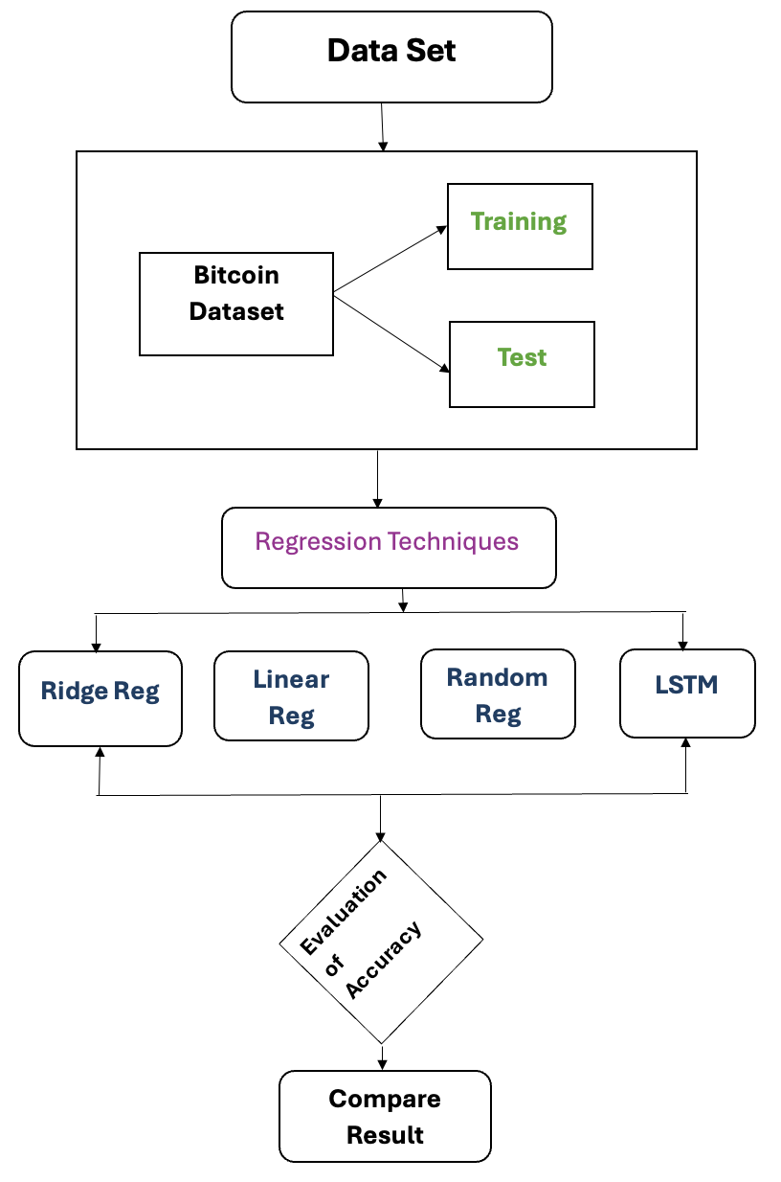
Methodology
­­­
We have used Machine learning techniques Like regression models.
We Analyzed the predictions through different models, such as Random Forest, Linear , Ridge and finally LSTM.
We found the model's parameters and their significance with accuracy /Result.

Slide 6
Model Training & Evaluation
As We have done Inferential analysis Using different type of Models – Regression- Linear regression, Ridge regression, Random forest & LSTM (All models & result shown below table)
After several training and testing, We applied Long Short-Term Memory (LSTM) Model by applying Machine Learning techniques.
Model | RMSE Score
Linear Regression | 491.35
Ridge Model | 568.12
Random Forest Regression | 713.25
LSTM (Time Series) | 140.169

Slide 7
Hypothesis
The case study aims to predict the price of bitcoin by keeping commodity assets, traditional financial instrument indices, and some bitcoin-related variables that can affect the price of bitcoin.
Translated above methodologies into a hypothesis we have formed a hypothesis below:
H0: None of the variables affect the price of bitcoin.
H1: At least one of the variables affects the price of bitcoin.

Slide 8
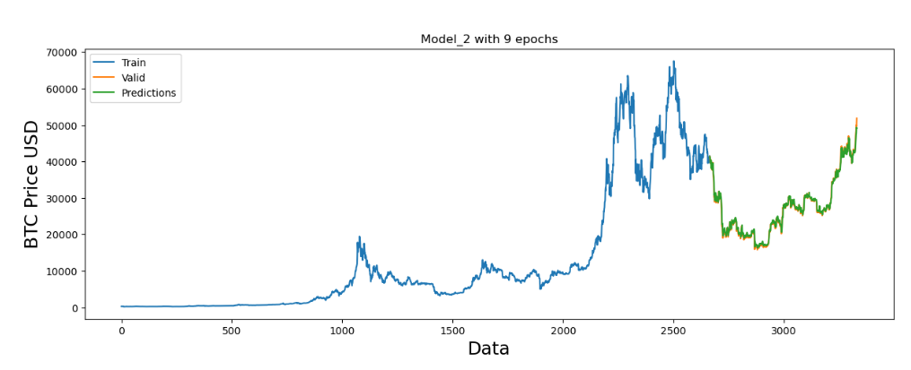
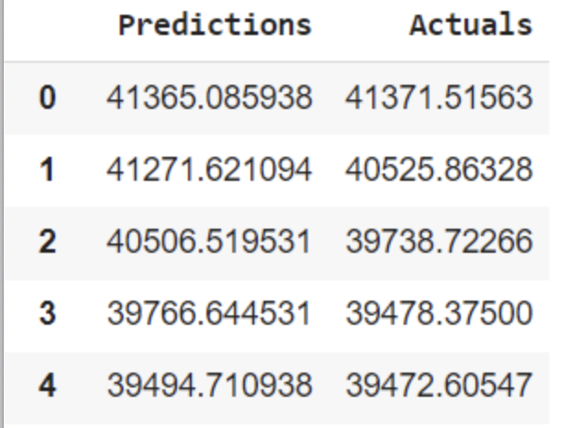
Result & Future Directions (Interpretation)
Through training and testing the model, we obtained a root mean square error (RMSE) score of 100.21, indicating minimal errors. This model demonstrated a strong fit during testing, leading us to conclude it as the best predictive model.

Slide 9

Conclusion
We showcased data-driven methods for predicting Bitcoin prices, pinpointing key factors affecting its fluctuations.
On the other hand, Various factors were also effected the predictions.
Despite ongoing challenges, our study offers valuable insights for future research in this area.

Slide 10



